Slide 1
The Labour Market Impacts of Forced Migration (LAMFOR): Tanzania
Funded by IZA/DFID
Carlos Vargas-Silva
COMPAS
University of Oxford

Slide 2
Discussion
Questions and objectives
Case study
Data used
Methodology
Considerations for the future

Slide 3
Questions and objectives
Objective: Exploring the labour market consequences of hosting refugees.
  Focus on outcomes of natives.
Motivation: Literature on labour market impacts of ‘forced’ migration small compared to ‘voluntary’ migration context.
Yet, refugees often join the labour market of the host country.

Slide 4
Paper 1
Main economic activities: farming/livestock work, self-employment (non-farm), employee.
Agricultural vs. non-agricultural employees.
Number of activities: possible role of diversification.
Change in types of crops: important change in economic activity not captured by change in primary activity.

Slide 5
Paper 1
Explore differences:
(pre-shock) Casual workers: expect casual workers to be particularly affected by the refugee shock.
Younger cohort: main analysis was for those 16 years of age or older during the first round.

Slide 6
Paper 2
Somewhat similar approach to main activities.
For employees:
Different sectors: agricultural, trade, government.
Type of occupation: professional.
Quality of job: earning a pension.

Slide 7
Paper 3 – in progress
Focus on females.
Consequences of hosting refugees not gender neutral.
    Substitutability and complementarity relationships between refugees and natives differ across genders.
    Occupational/activities segregation by gender.
    Increase in foreign assistance has different impacts by gender.

Slide 8
Case Study
Tanzania
Major ethnic civil conflicts in Burundi and Rwanda during the years 1993 and 1994.
Hundreds of thousands of people abandoned these two countries and moved to neighbouring Tanzania in order to escape the violence.

Slide 9
Context
Mostly encampment in a rural area.
Rwandans returned after a few years.
Burundians much longer process.
  Last camp in region closed in 2008.
  Burundians have since returned to the region (over 100k now in Tanzania).

Slide 10
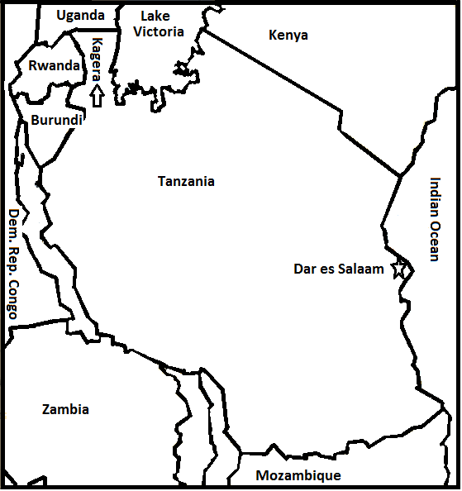

Slide 11
Data
Kagera Health and Development Survey (KHDS).
Longitudinal: rounds 1991 – 1994, 2004 and 2010.
Data pre, during and post refugee shock.
Rich dataset, good tracking over time, reliable.
Collected in 51 communities, but individuals tracked even if they move out of the community.
Limitation: it does not include refugees.

Slide 12
Complementary data (now available)
LAMFOR survey (1,500 households) in Burundi (2015, previous round in 2011).
Ask returnees about their experiences in Tanzania.
Replicates the questions of the KHDS about economic activities, etc.
Good way of “re-constructing” impact on hosts after the “end” of the refugee shock.

Slide 13
Methodology: need to create a counter-factual
Compare to communities not affected (less affected) by refugee shock.
Classical selection problem.

Slide 14
Methodology: Key role of distance
Displacement on foot.
Natural topographic barriers.
Logistical decisions.
Refugees not evenly distributed across Kagera.
Higher concentration western part in comparison to the eastern part.
    Highlighted by others: Baez (2011), Maystadt and Verwimp (2014).

Slide 15
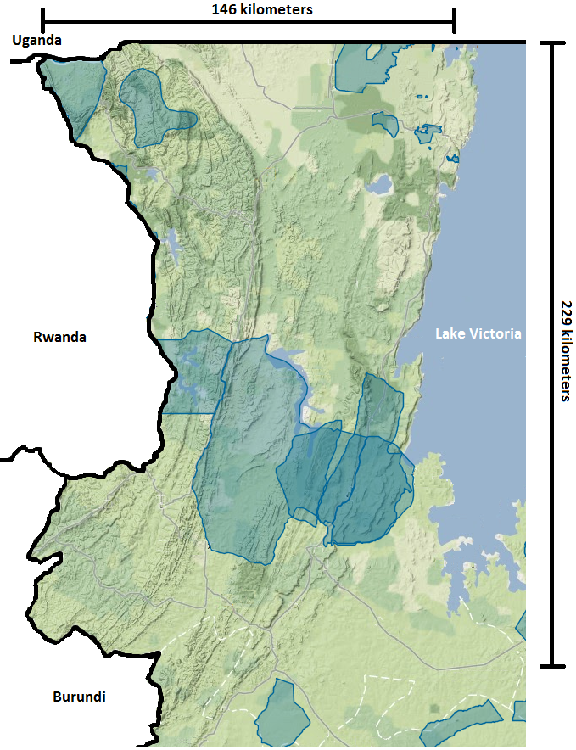
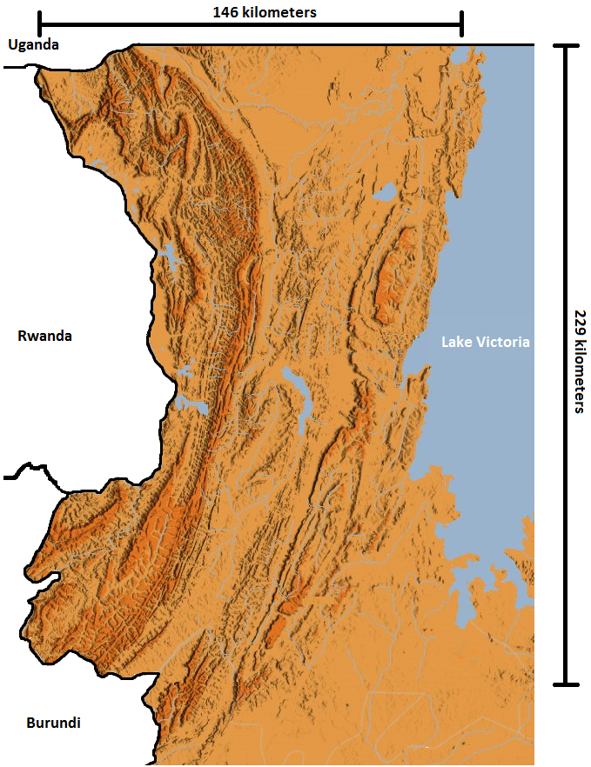

Slide 16
Use distance measures for identification purposes.
Distance to the borders: useful when no good measures of refugee numbers per location. Also, while most were refugees in camps, not all.
  Burundi.
  Rwanda.
  Weighted: between the two.
  Weighted: by refugee population from of each country in Kagera.
  Other possibilities: east-west split (Baez, 2011).

Slide 17
Use distance measures for identification purposes.
Distance to refugee camps.
  Weighted: by largest estimate of population of camps and by years camp was open.
    Other possibilities: weight by population in a given year (Maystadt and Verwimp, 2014).
    Need to show no effect of distance on pre-shock outcomes, exogeneity, etc.
  Rich 1991 dataset helps.

Slide 18
In the estimation
Create a “shock variable” based on interaction between time (pre-shock = 0, post-shock = 1) and distance.
Explore results focusing on that variable.
Similar to regular DID.

Slide 19
Role of previous fieldwork, accounts and reports
Reports from UNHCR on camps, refugee numbers, transfers, returns essential to construct instrument.
Narratives of the situation particularly useful (e.g. Whitaker, 2002).
Historical analysis of the region (e.g. Mbilinyi (1986) – about casual labour).

Slide 20
Potential use for IDPs
Distance useful for identification if it is a regional conflict.
Other cases more challenging.
Also, more difficult to separate the effect of conflict.

Slide 21
Considerations for the future
Essential:
  Pre and post refugee shock data (ideal during).
  Good identification. Distance ideal for many cases, not all.
  Exogenous allocation of refugees for logistical reasons also possible.
  Good knowledge
    of region
    overall logistics (e.g. external assistance)
    allocation policies

Slide 22
Considerations for the future
  Dynamic impacts on hosts:
  Data on refugee characteristics and numbers over time.
  Who arrives first vs later?
  Changing policies of host country.
  Have data on returnees.
  Who returns first vs later?
  Any connections with host region after return? (e.g. trade).
  Clearer distinction between short, medium and long-term impacts.

Slide 23
Considerations for the future
Role of border crossings.
  Good historical data.
  Open/close at different points with implications for timing of inflows and timing of returns (e.g. voluntary repatriations).
  Possible role in identification.

Slide 24
Considerations for the future
  Impact not limited to ‘hosts’ residing in the affected location
  Inflows to trade with refugees
    Difficult to capture with longitudinal data.
  Outflows to other areas to “scape” refugee shock
    Implications for residents of other areas.
    Impact can be “dispersed” to other areas via internal native migration.
    Difficult to capture with data from just one region.

Slide 25
Thanks!
References
Paper 1: Ruiz, I. and Vargas-Silva, C. 2015. “The Labor Market Consequences of Hosting Refugees” Journal of Economic Geography.
Paper 2: Ruiz, I. and Vargas-Silva, C. 2015. “The Labor Market Impacts of Forced Migration” American Economic Review Papers and Proceedings.

