Slide 1
Migration Costs for Low Skilled Workers: India-Qatar Corridor
Prabhu Mohapatra
University of Delhi
KNOMAD
Workshop on Measuring Migration Costs for the Low-skilled
The World Bank, Washington DC
November 16-17, 2015

Slide 2
Regulation of Low Skilled Labour Migration from India
Legislative Measures
Emigration Act 1983 provides the regulatory framework for governing low skilled labour migration from India
Emigration Rules stipulates that emigration clearance is required for those migrating for employment to 18 countries (emigration check required countries – mainly Gulf countries)

Slide 3
Regulation of Low Skilled Labour Migration from India
Rules states that emigration clearance is required only by persons whose educational attainment is below higher secondary (matriculate- 10th Grade )
Emigration clearances are granted by the Protector of Emigrants (in 10 POE offices in the country) after verifying employment contracts and other related documents
The Act and Rules have elaborate provisions for governing the operation of the recruiting agencies ranging from issuing of registration certificate to offences and penalties

Slide 4
Regulation of Low Skilled Labour Migration from India
Executive Orders
Government of India has been increasingly resorting to executive orders ( reference to the Act and otherwise) to manage various dimensions of labour flows, like setting limits to agency fees, setting minimum wages, operationalising welfare schemes etc.
Bilateral agreements with major labour receiving countries to manage migration

Slide 5
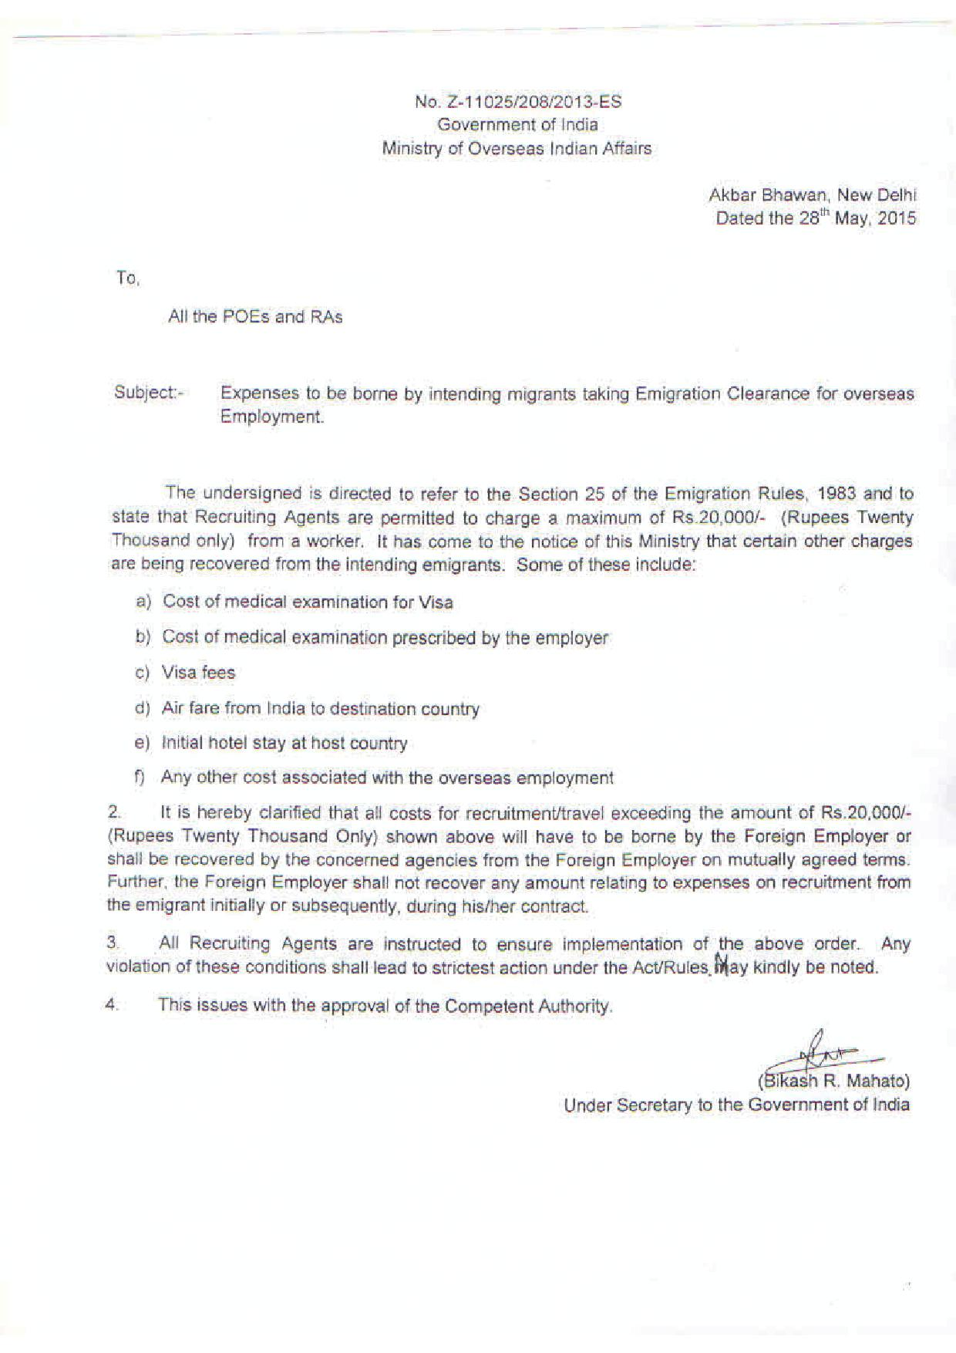
Regulation of Low Skilled Labour Migration from India

Slide 6
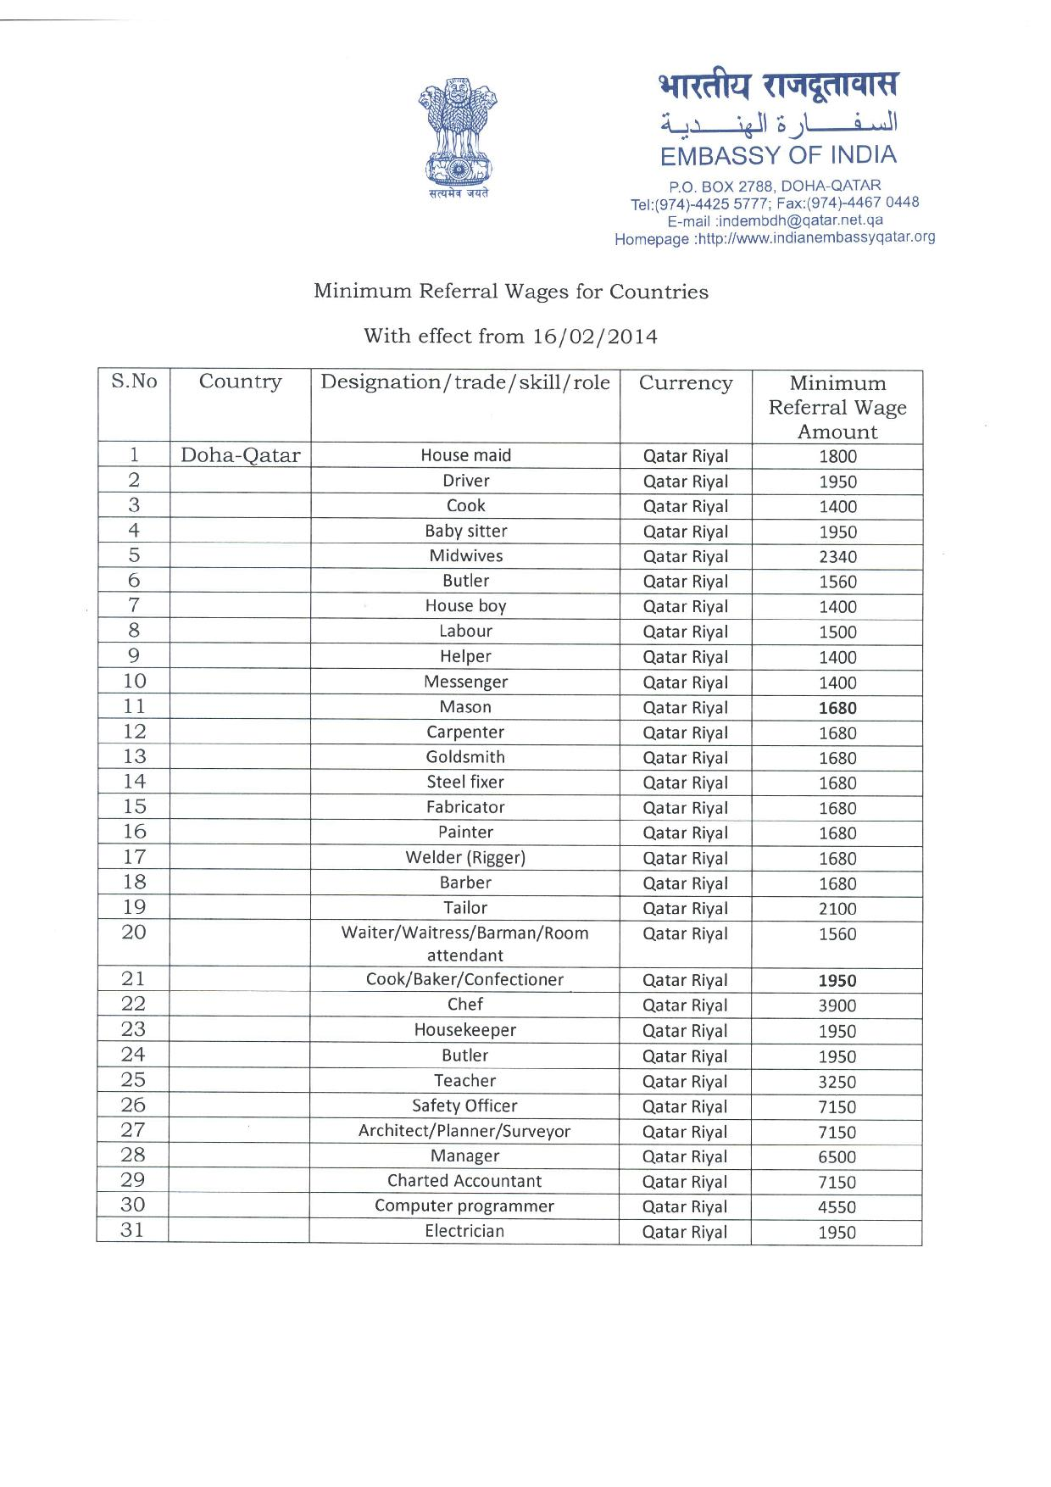
Regulation of Low Skilled Labour Migration from India

Slide 7
Regulation of Low Skilled Labour Migration from India

Slide 8
India-GCC Migration
India-GCC, a major corridor of contemporary international migration flows
Stock of Indian migrants in GCC countries have increased from 2.4 million in 1990 to 6.8 million in 2013
Indian migrants account for nearly 30 per cent of the estimated 22 million migrants in GCC Countries in 2013
Proportion of Indian migrants is relatively high in all GCC Countries

Slide 9
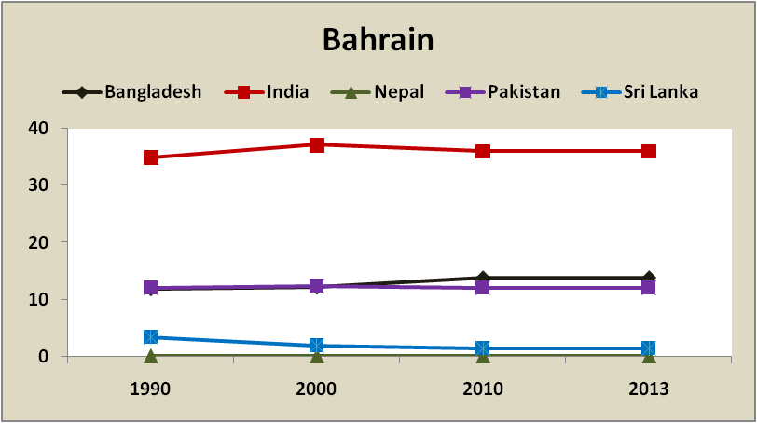
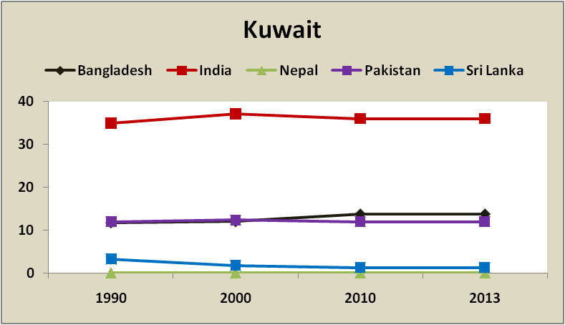
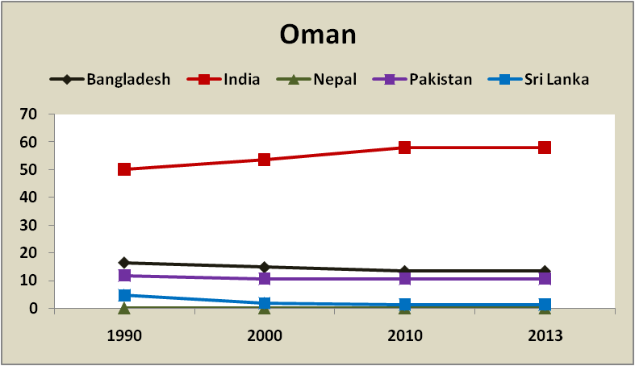
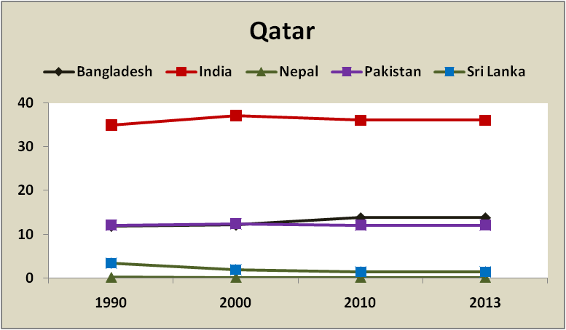
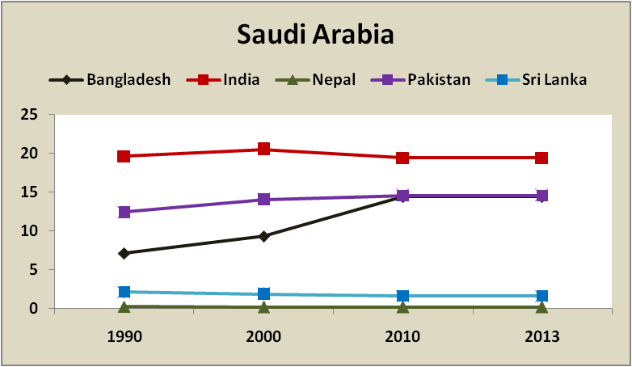
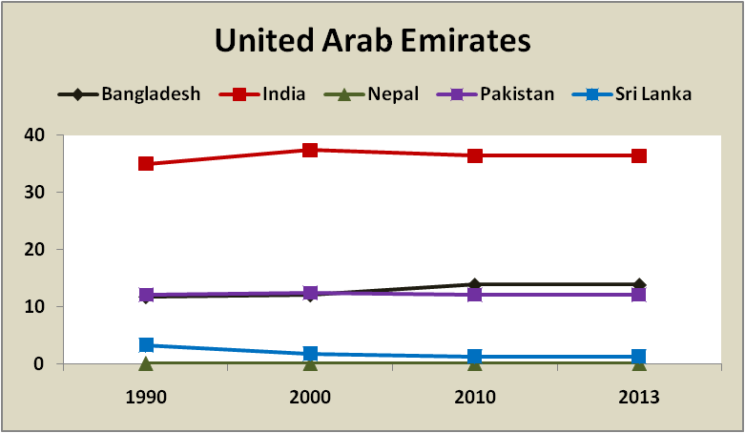
South Asian Migrants in GCC: 1990-2013 (Percentage of Migrants to the Total Migrants)
Source: United Nations Department of Economic and Social Affairs.

Slide 10
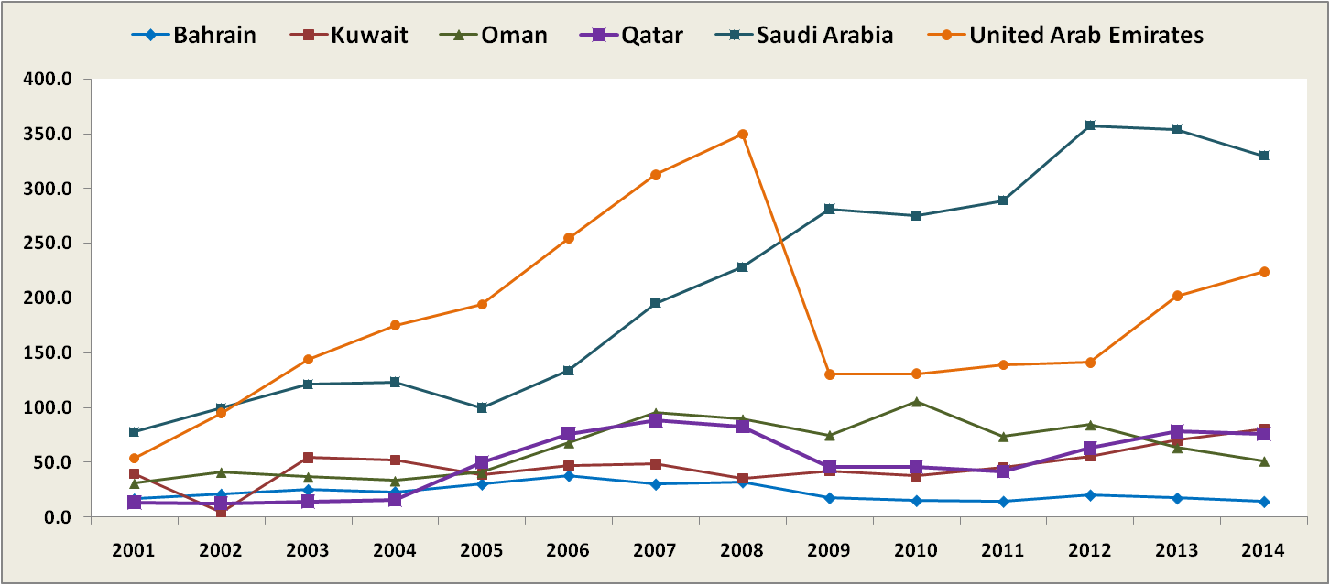
Indian Labour Migration Flows to GCC Countries: 2001-2014
(in ‘000)
Note: Figures relate to the number of emigration clearance granted.
Source: Ministry of Overseas Indian Affairs, Annual Reports.

Slide 11
India-Qatar Migration Flows
Significant increase in the Indian migrant population in Qatar during 1990-2013 - from 129,147 in 1990 to 576,776 in 2013
Indians accounted for 36.1 per cent of the total migrant populations in Qatar in 2013
An overwhelming majority (82 per cent) were males

Slide 12
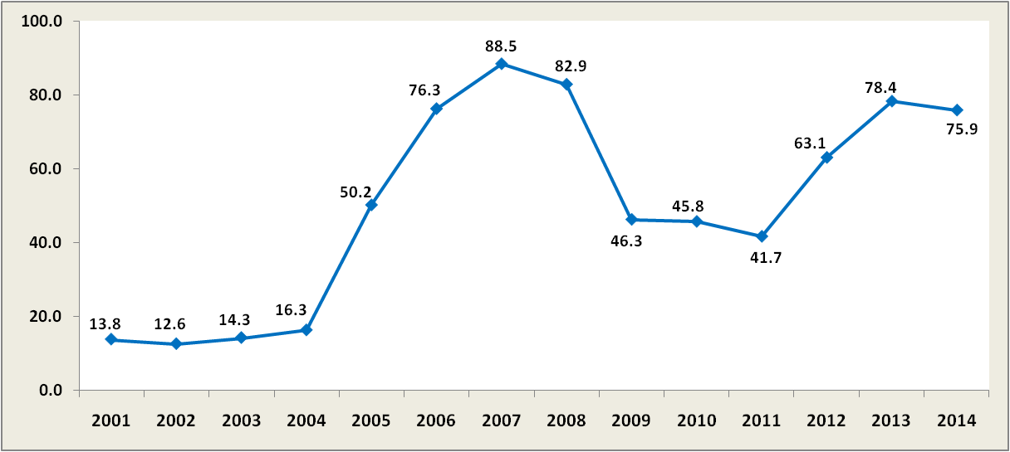
Indian Labour Migration to Qatar: 2001-2014
(in ‘000)
Note: Figures relate to the number of emigration clearance granted.
Source: Ministry of Overseas Indian Affairs, Annual Reports.

Slide 13
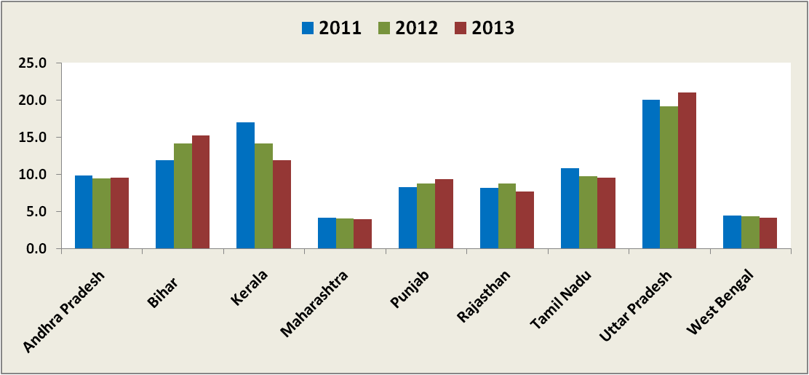
% Distribution of State-wise (Major States) Emigration Clearances to Qatar
Source: Ministry of Overseas Indian Affairs.

Slide 14
Sample Design
The first stage of the survey involved broad profiling of migrant workers returning from Qatar to India
Profiling included both current migrants (those travelling to India on vacation and expected to return to Qatar within a short time) and return migrants (those returning after completing their contractual obligations)

Slide 15
Sample Design
Profiling at three major airports, Mumbai, Delhi and Hyderabad
To cover migrants originating from high out-migration of Andhra Pradesh, Bihar, Haryana, Maharashtra, Madhya Pradesh, Odisha, Punjab, Rajasthan and Uttar Pradesh
Selected states were Hindi speaking states – that way two major out migration States, Kerala and Tamil Nadu were not included in the survey
Basic profiling covered nearly 1200 migrants

Slide 16
Sample Design
Sample pre-fixed at 350 migrants
Sample of 401 was drawn to take care of any possible sample loss by considering following inclusion criteria:
Those returning from Qatar
Last migration episode must be after 2011
Only low skilled male construction workers

Slide 17
Sample Characteristics
Distribution of Sample by State
State | No. | %
Andhra Pradesh | 37 | 9.23
Bihar | 74 | 18.45
Gujarat | 12 | 2.99
Haryana | 24 | 5.99
Maharashtra | 67 | 16.71
Madhya Pradesh | 14 | 3.49
Punjab | 18 | 4.49
Rajasthan | 35 | 8.73
Uttar Pradesh | 109 | 27.18
Others | 11 | 2.74
Total | 401 | 100.00

Slide 18
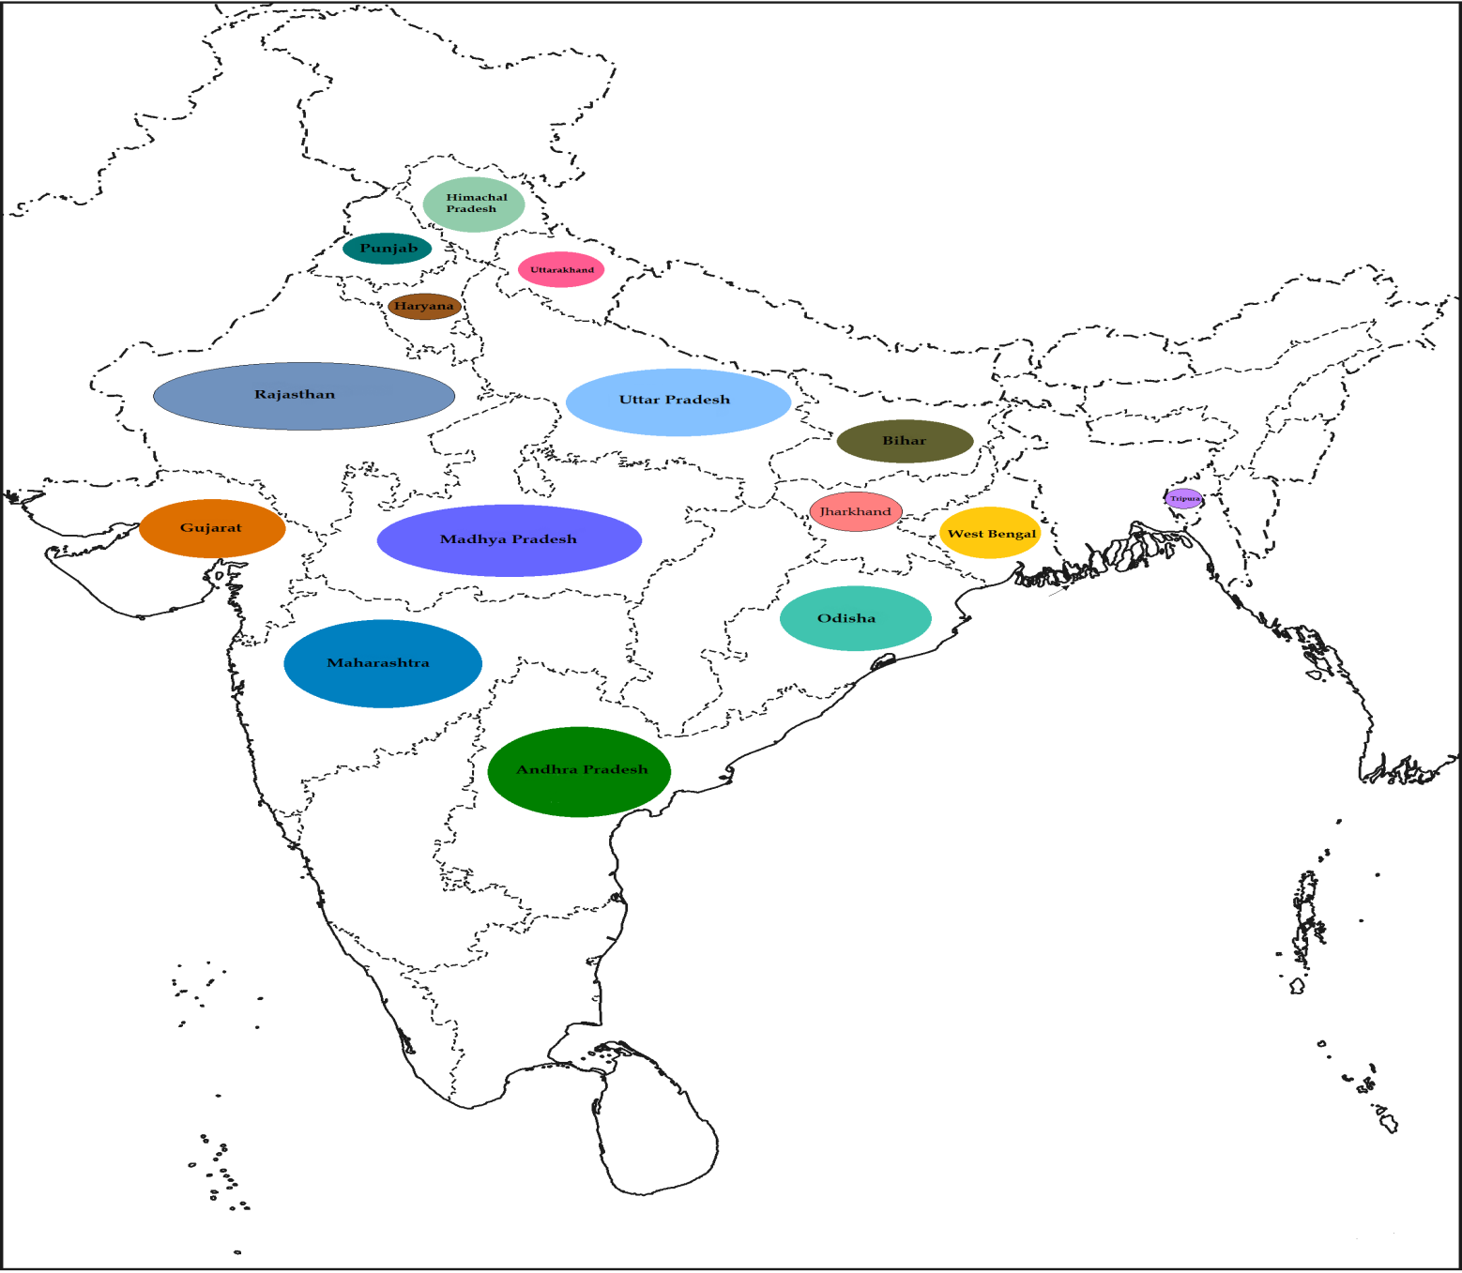
Selected States

Slide 19
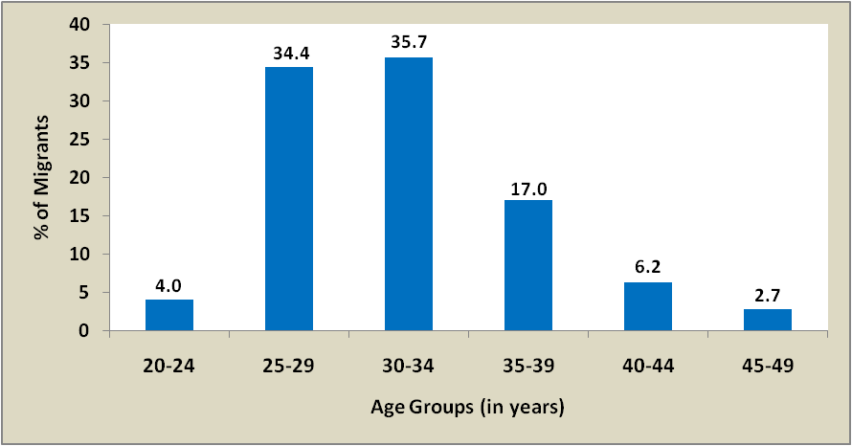
Sample Characteristics
Age Composition of Migrants
(in %)

Slide 20
Sample Characteristics
Distribution of Respondents by Year of Most Recent Migration
Year | Number | %
2011 | 98 | 24.50
2012 | 151 | 37.75
2013 | 119 | 29.75
2014 | 32 | 8.00
All Years | 400 | 100.00

Slide 21
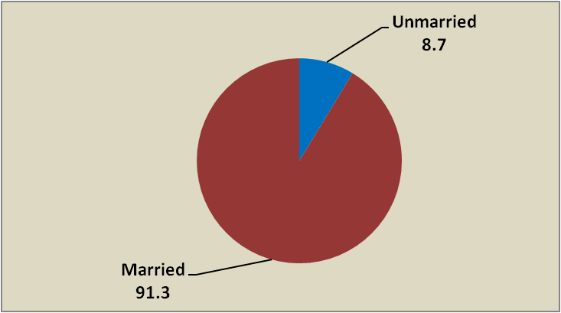
Sample Characteristics
Percentage Distribution by Marital Status

Slide 22
Sample Characteristics
Distribution of Sample by Level of Education
Level of Education | No. | %
Primary | 3 | 0.75
Primary but below high school | 348 | 86.79
Post Sec (incl. vocational training) | 50 | 12.47
Total | 401 | 100.00

Slide 23
Sample Characteristics
Distribution of Sample by Family Support
People Support | No. | %
Up to 3 | 6 | 1.50
4-5 | 214 | 53.37
6-7 | 158 | 39.40
8 & more | 23 | 5.74
Total | 401 | 100.00
Average number of family members supported | 5.5

Slide 24
Sample Characteristics
Percentage Distribution of Sample by State and Family Support
State | People Support |  |  |  | Total
 | Up to 3 | 4 – 5 | 6 - 7 | 8 & more
Andhra Pradesh | 0.00 | 48.65 | 51.35 | 0.00 | 100.00
Bihar | 0.00 | 47.30 | 40.54 | 12.16 | 100.00
Gujarat | 0.00 | 41.67 | 58.33 | 0.00 | 100.00
Haryana | 0.00 | 58.33 | 41.67 | 0.00 | 100.00
Maharashtra | 0.00 | 56.72 | 40.30 | 2.99 | 100.00
Madhya Pradesh | 0.00 | 57.14 | 42.86 | 0.00 | 100.00
Punjab | 0.00 | 77.78 | 22.22 | 0.00 | 100.00
Rajasthan | 0.00 | 62.86 | 37.14 | 0.00 | 100.00
Uttar Pradesh | 5.50 | 51.38 | 33.94 | 9.17 | 100.00
Others | 0.00 | 36.36 | 45.45 | 18.18 | 100.00
Total | 1.50 | 53.37 | 39.40 | 5.74 | 100.00

Slide 25
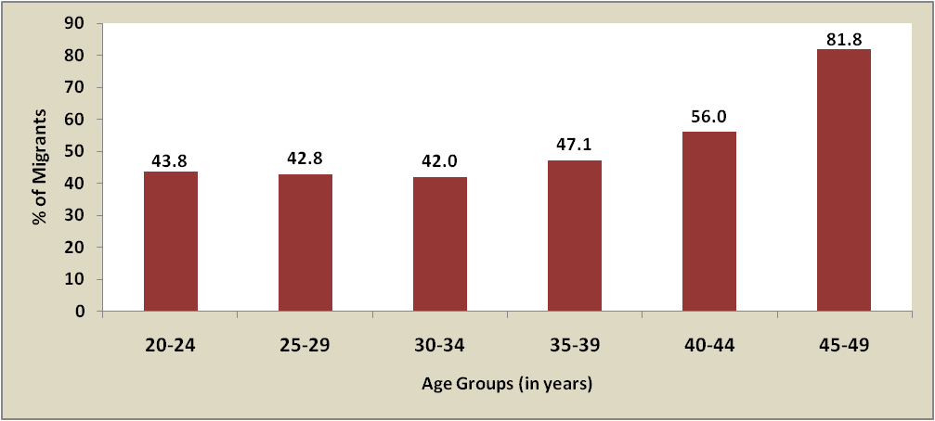
Sample Characteristics
Percentage of Migrants by Age Groups Supporting
More than 5 Family Members

Slide 26
Sample Characteristics
Distribution of Sample by Frequency of Migration
First Outside | No. | %
First time | 311 | 77.56
More than once | 90 | 22.44
Total | 401 | 100.00

Slide 27
Sample Characteristics
Percentage Distribution of Sample by Age Groups and
Frequency of Migration
Age Group | First Outside |  | Total
 | First Time | More than Once
20-24 | 100.00 | 0.00 | 100.00
25-29 | 92.75 | 7.25 | 100.00
30-34 | 78.32 | 21.68 | 100.00
35-39 | 70.59 | 29.41 | 100.00
40-44 | 20.00 | 80.00 | 100.00
45-49 | 18.18 | 81.82 | 100.00
Total | 77.56 | 22.44 | 100.00

Slide 28
Sample Characteristics
Distribution of Sample by Source of Information and
Means of Recruitment
 | Source of Information |  | Means of Recruitment
 | No. | % | No. | %
Agent/broker/recruiter | 149 | 37.16 | 387 | 96.51
Relatives/friends | 252 | 62.84 | 14 | 3.49
Total | 401 | 100.00 | 401 | 100.00

Slide 29
Sample Characteristics
Distribution of Respondents by Skill Tests Taken
Skill Test | No. | %
Yes | 295 | 73.57
No | 106 | 26.43
Total | 401 | 100

Slide 30
Major Lessons/Challenges
Airports may be the ideal site for conducting CAPI based surveys
Most migrants tend to report costs in a consolidated manner
Interviewers need to be very well trained to explain the components of costs and obtain the relevant information
Difficulties encountered in direct on line transfer of questionnaires to CAPI server due to lack of internet penetration, particularly in rural areas
Similar surveys in major migration corridors can provide significant inputs to formulate policies and programmes for reducing costs of low skilled migration

Slide 31
On Survey Questionnaire - Returnee
Comprehensive to capture different dimensions of migration costs
Some Confusing Options/Questions and Unanswered Questions
option between recruitment agent/broker and manpower agency (q.no. 2.1 – variable: job_application_how)
visa costs (q.no. 2.40 – variable: cost_visa) – Visa is obtained by the employer and forwarded to worker through agent or directly. Agents may charge an amount in the name of visa , so should that not be regarded as agent’s fees?)

Slide 32
On Survey Questionnaire - Returnee
use of skills (q.no. 4.18 – variable : believe_useskill; and 4.19 – variable: amount_useskills) involves subjectivity and assumes availability of all labour market information with respondents)
taxes, social security, foreign worker levy (q.no. 5.20 – variable: amount_deducted ) – respondents not able to give satisfactory responses
amount sent home (q.no. 5.24 – variable: amount_sent) – responses refers to their savings and not remittances per se, some part of these may be remitted , some portion transferred through friends or some part carried along while they return home)

Slide 33
CAPI Method : Our Feedback
Very User Friendly
Pre Survey Training to interviewers important
Presence of CAPI team member(s) during such training at the survey centre is very critical
Direct on line transfer of questionnaires to CAPI server had problems due to lack of internet penetration, particularly in rural areas

Slide 34
THANK YOU

